Slide 1
Front End Engineering-I Project
Team Details:
Ritesh Anand: 2410991620
Ritish Mahajan:2410991621
Parth Mittal:2410991564
Faculty Coordinator: DR. N. Bharathiraja
:
Chitkara University Institute of Engineering and Technology,
Chitkara University, Punjab

Slide 2
Table of Contents
Introduction
Problem Statement
Technical Details
Key Features
Project Highlights
Bonus Feature(optional)
Conclusion
References/Links used

Slide 3
Introduction
Flexible Access
Digital Education
Personalized Learning
Wide Application
Diverse Formats

Slide 4
PROBLEM STATEMENT
Limited Accessibility: Some individuals are denied quality education due to such geographical and financial barriers, mostly found in remote or underprivileged locations.
Lack of Flexibility: The conventional system of education is not flexible enough in time and does not open their doors for working professionals, parents, and others with commitments.
Time Factor: Many students require the luxury of learning at their own discretion, which is not often permitted in other traditional teaching methods.

Slide 5
Technical Details
Software Details: Visual Studio Code version 1.83
Language used:
HTML- HTML stands for Hyper Text Markup Language. HTML is the standard markup language for creating Web pages. HTML describes the structure of a Web page.
CSS- Cascading Style Sheets (CSS) is a style sheet language used for describing the presentation of a document written in a markup language such as HTML
JavaScript- JavaScript is a scripting or programming language that allows you to implement complex features on web page

Slide 6
Key Features
User-Friendly Interface:
Intuitive navigation and responsive design for easy access across devices.
Course Management:
Navigation, organization, and management of courses, modules, and lessons.
Ability to ask doubts
Content Delivery: Support for video lectures, live streaming, and downloadable materials. Integration with third-party content providers

Slide 7
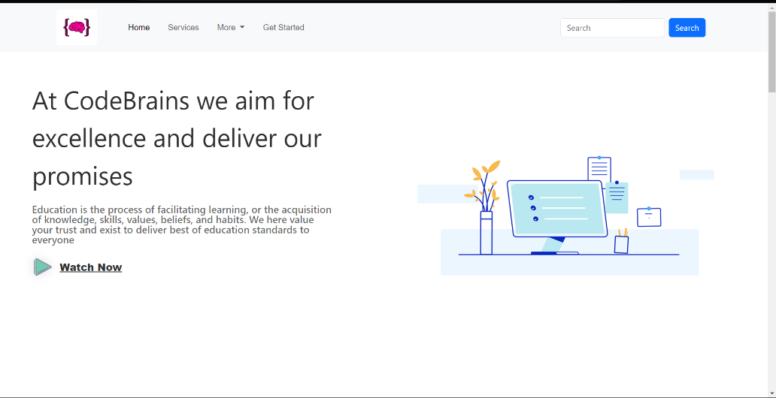
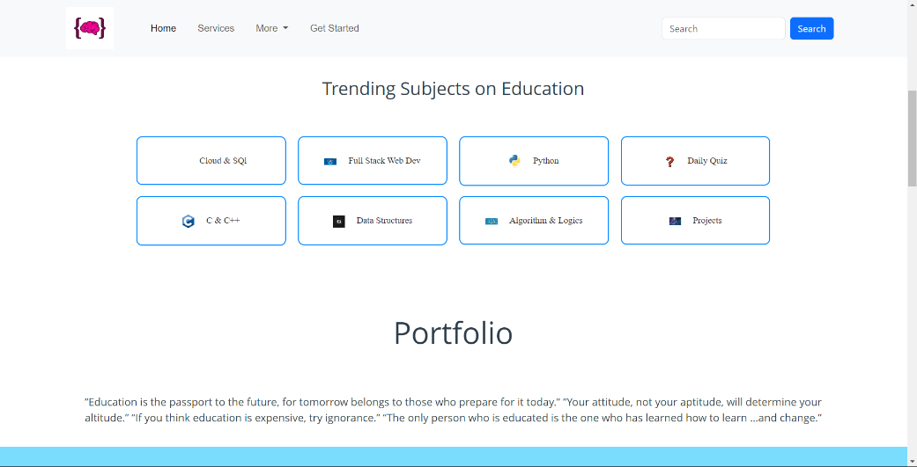
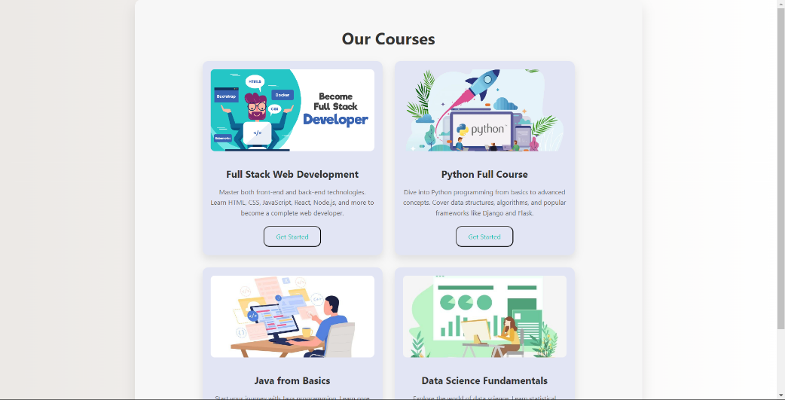
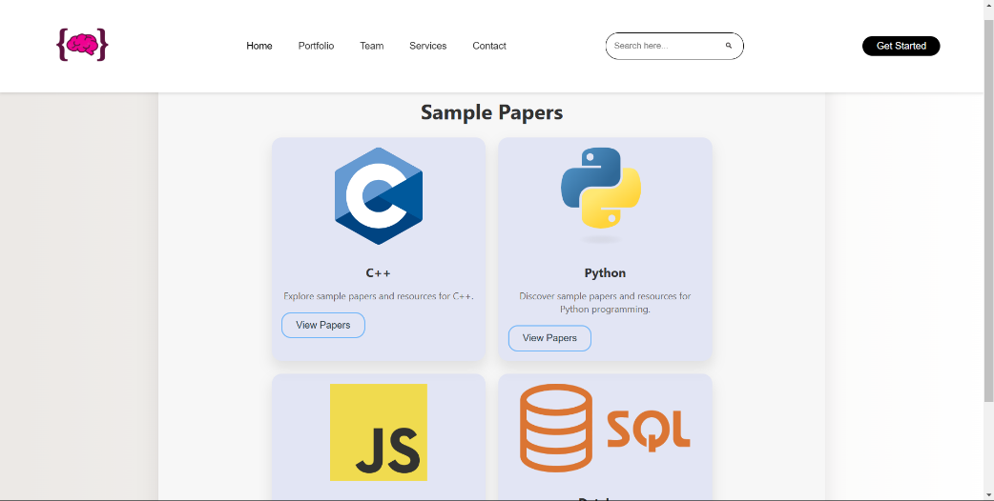
Project Highlights

Slide 8

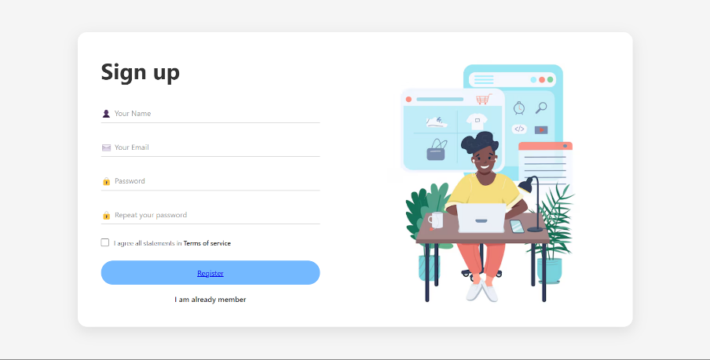
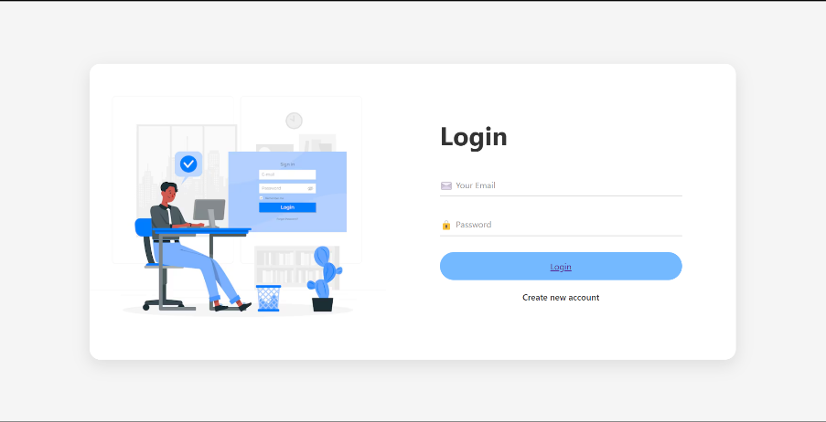
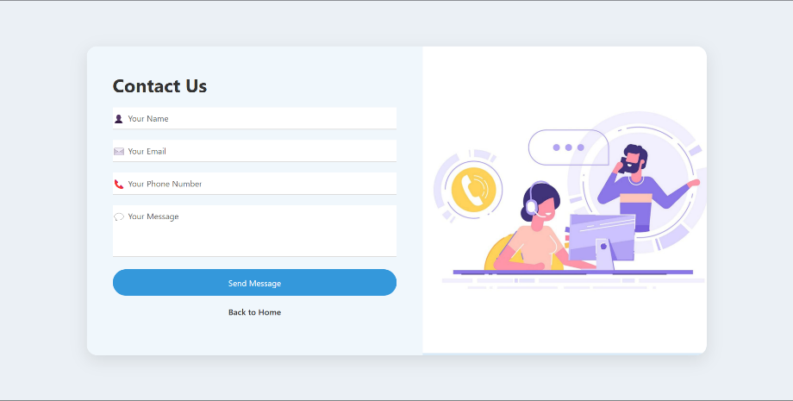
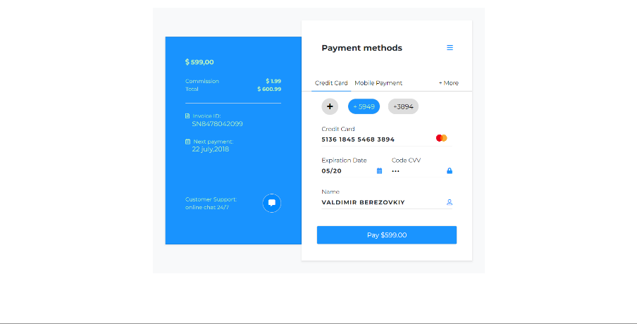

Slide 9
Bonus Feature
Cross-platform compatibility : The streaming website work well across a range of devices and platforms, including iOS, Android, mobile, or desktop.
Security : CODE BRAINS provides all its users an option of User sign in, which secures the system using unique username and password combination.

Slide 10
Conclusion
Our project on e-learning site will be a transformational approach to modern education as it promises flexibility, accessibility, and personalization to people. With restrictions of geographically and time-independent traditional classrooms in the way, e-learning platforms address diverse needs of students, professionals, and lifelong learners through courses and learning opportunities. The integration of self-paced learning, real-time feedback, and interactive multimedia elements would make sure it was an entertaining and effective educational experience. This project represents the potential of digital learning in filling gaps in education, creating a culture of continuous development in skills, and accelerating the sharing of knowledge everywhere globally.

Slide 11
References/Links used
MDN WEB DOCS
W3SCHOOL
YOUTUBE

Slide 12


